Slide 1
Pre-visit information for primary school teachers

Slide 2
Thank you for booking your visit to
ZSL London Zoo
This resource is designed to give you all the information you need for your visit and is structured into the following sections:
Before your visit – a checklist to ensure you are prepared for your day
How to get to the Zoo – arriving by public transport
On the day of your visit
Information to help prepare your students
After your visit to ZSL London Zoo

Slide 3
1. Before your visit to ZSL London Zoo
Have you:
Received your confirmation letter from ZSL London Zoo? Print this to bring with you on the day
Used the teachers’ map (showing toilets, places to eat lunch and more) to plan your route around the Zoo? static.zsl.org/files/london-zoo-schools-previsit-booklet-apr-2013-2428.pdf
Planned which free talks and shows to attend on the day? www.zsl.org/zsl-london-zoo/visit/daily-events/
Printed free self-guided activity sheets you could use with your class? www.zsl.org/zsl-london-zoo/schools/pre-visit-checklist
Checked out the information for your risk assessment? www.zsl.org/education/risk-assessment,82,AR.html

Slide 4
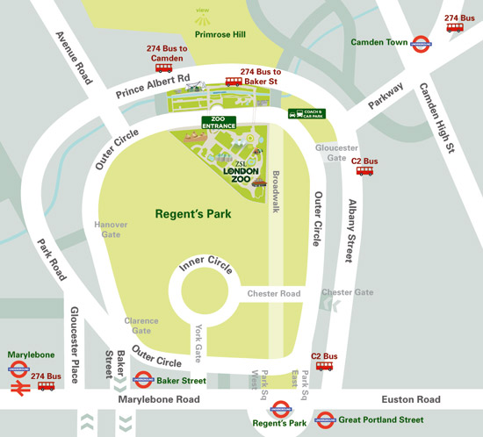
2. Getting to the Zoo – arriving by public transport
From Camden Town station (15 minute walk)
Camden Town is the nearest tube station to ZSL London Zoo with its Northern Line connection.
Alternatively you can get the tube to Baker Street, Regent’s Park or Great Portland Street Stations.
.
From Baker Street, you can take the 274 bus, or it is a 30 minute walk
From Regent’s Park and Great Portland Street, you can take the C2 bus, or it is a 20 minute walk through Regent’s Park to the zoo

Slide 5
2. Getting to the Zoo – directions from Camden Town
Exit the station on the right-hand side and walk along Parkway
Continue walking up Parkway for about 6 minutes until you reach Prince Albert Road.
Turn right into Prince Albert Road and continue for about five minutes until you reach the traffic-light controlled pedestrian crossing.
Cross left here and walk over the Regent's Canal footbridge
Turn right and ZSL London Zoo is then 200 metres up the road on the left-hand side.

Slide 6
3. On the day of your visit to ZSL London Zoo
Enter the Zoo through the Main Entrance and show your confirmation letter to the gate staff
If you need to be invoiced – the gate staff will organise this for you
You are welcome to bring packed lunches with you, or there are various catering outlets throughout the Zoo where you can buy lunch http://www.zsl.org/zsl-london-zoo/visitor-information/feeding-time
The first aid and lost child point is a clock tower in the centre of the Zoo. If anyone goes missing, please alert a staff member and they will take you to this point
Supervision ratios - It is Zoo policy that all children under 16 must be accompanied by an adult, therefore all school groups must be supervised throughout their trip. If any group is unsupervised, teachers will be tannoyed and asked to re-join their group

Slide 7
4. Helping your students prepare for their visit
This section is designed to help your students prepare for their visit. It covers:
When you arrive at the Zoo
Places to see in the Zoo
A session with a Discovery & Learning Officer
Free talks and shows to see
Some extra information
When you leave the Zoo
If you choose to display this pdf in viewing mode in a presentation to your students, please refer to the pages that are relevant to your visit.

Slide 8
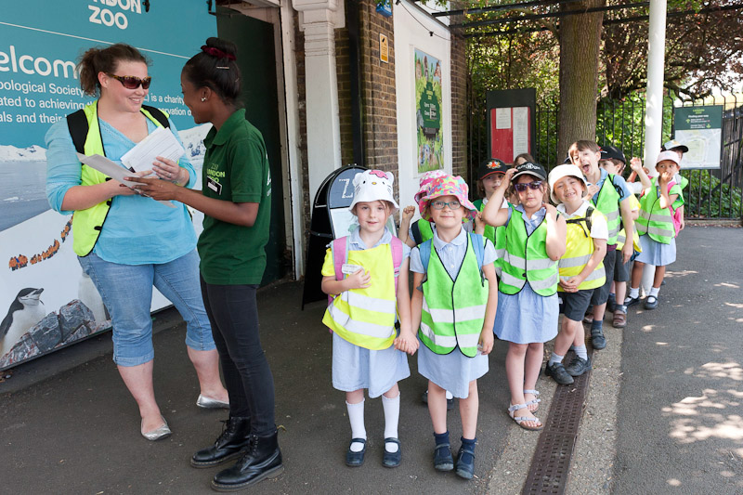
A. When you arrive at the Zoo
You will enter ZSL London Zoo through the Main Entrance

Slide 9
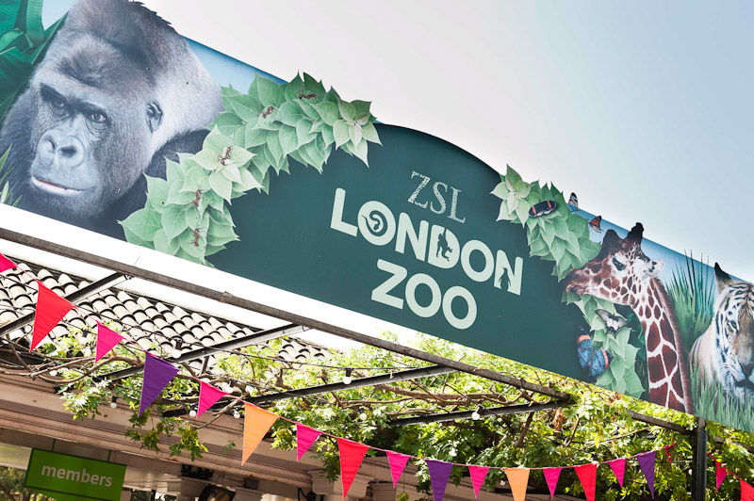
B. Places to see in the Zoo
At ZSL London Zoo, we have a lot of different places for you to visit and there are over 700 different kinds of animal for you to meet…

Slide 10
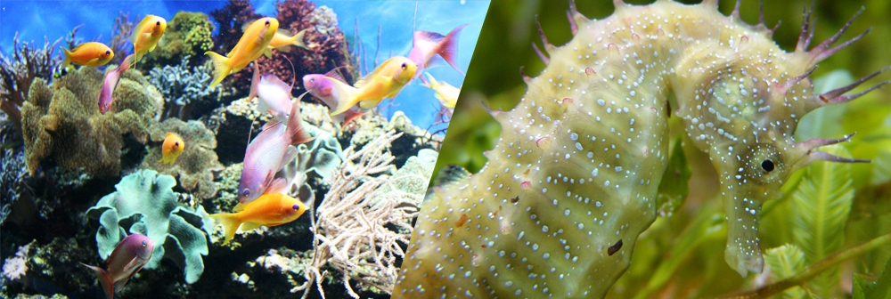
The Aquarium www.zsl.org/zsl-london-zoo/exhibits/aquarium/
Seahorses, tropical fish, piranhas and more!

Slide 11
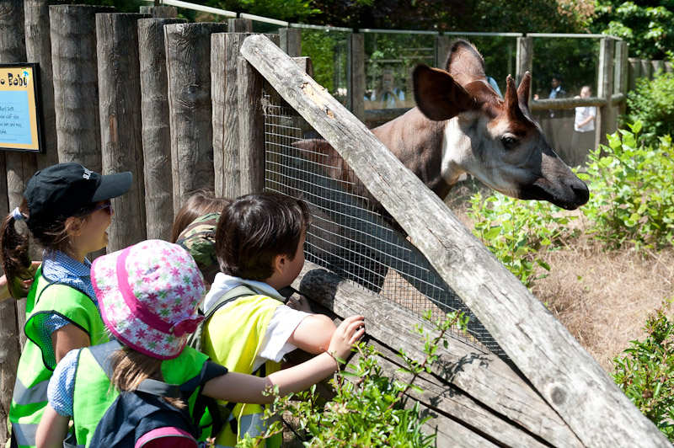
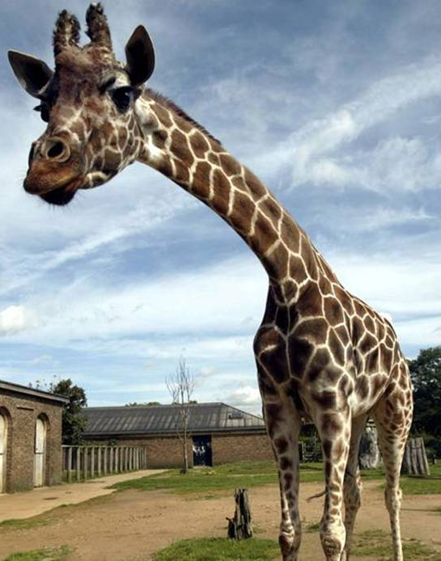
Into Africa
www.zsl.org/zsl-london-zoo/exhibits/into-africa
At Into Africa you could meet Leila the okapi and Ellish the giraffe

Slide 12
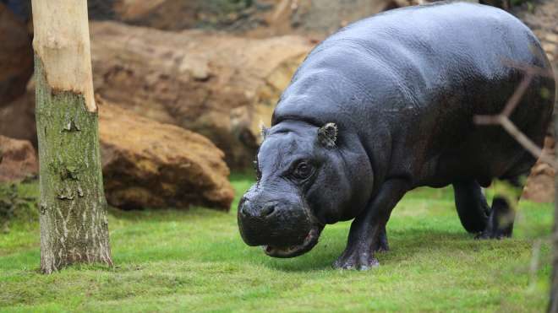
Pygmy Hippos
www.zsl.org/zsl-london-zoo/exhibits/pygmy-hippos
Meet our African pygmy hippos Thug (male) and Nicki (female)

Slide 13
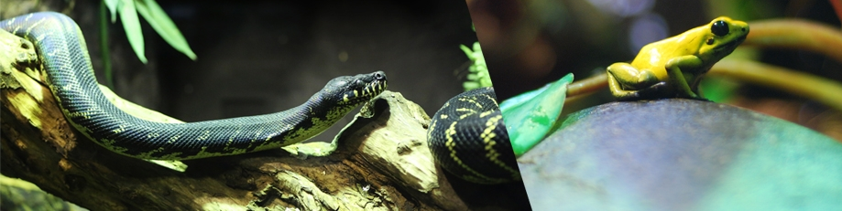
The Reptile House
www.zsl.org/zsl-london-zoo/exhibits/reptile-house
See snakes, lizards, amphibians, giant tortoises… and Raja the Komodo dragon

Slide 14
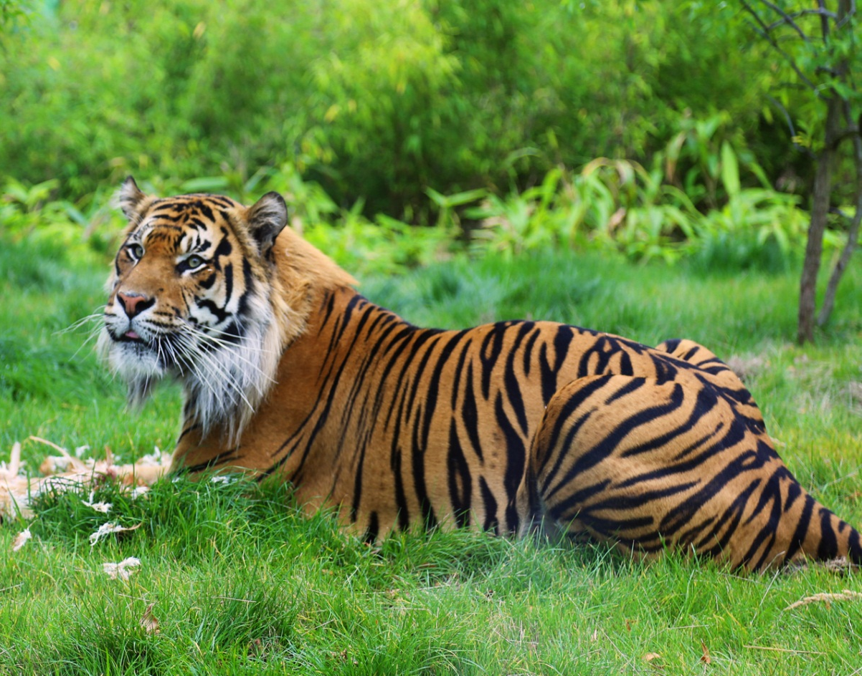
Tiger Territory www.zsl.org/zsl-london-zoo/exhibits/tiger-territory/
Meet Jae Jae (male), Melati (female) and their cubs, our Sumatran Tiger family

Slide 15
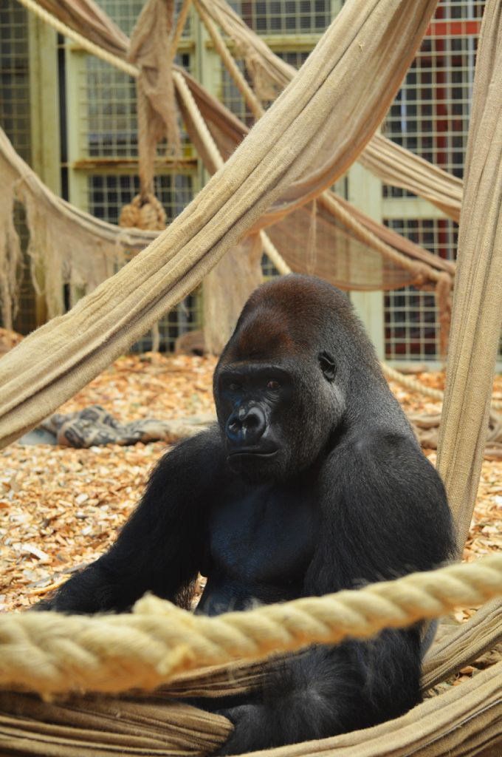
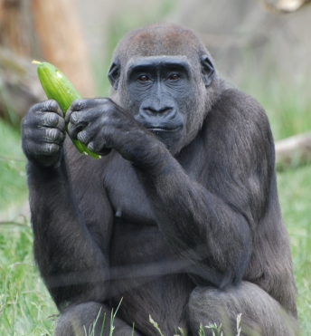
Gorilla Kingdom www.zsl.org/zsl-london-zoo/exhibits/gorilla-kingdom/
You could spot Kambuka the enormous male gorilla, or one of our three females

Slide 16
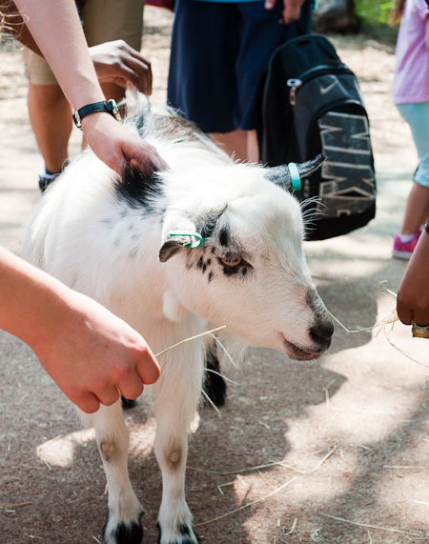
Animal Adventure www.zsl.org/zsl-london-zoo/exhibits/animal-adventure
In our Children’s Zoo “Animal Adventure” you can swing in the trees like a coati, crawl through a tunnel to see the meerkats, and stroke the animals in the Touch Zone farm

Slide 17
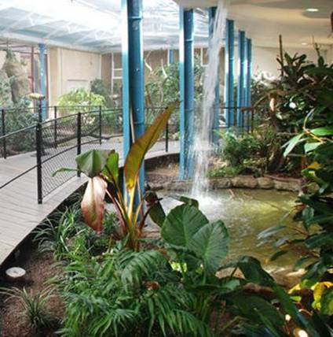
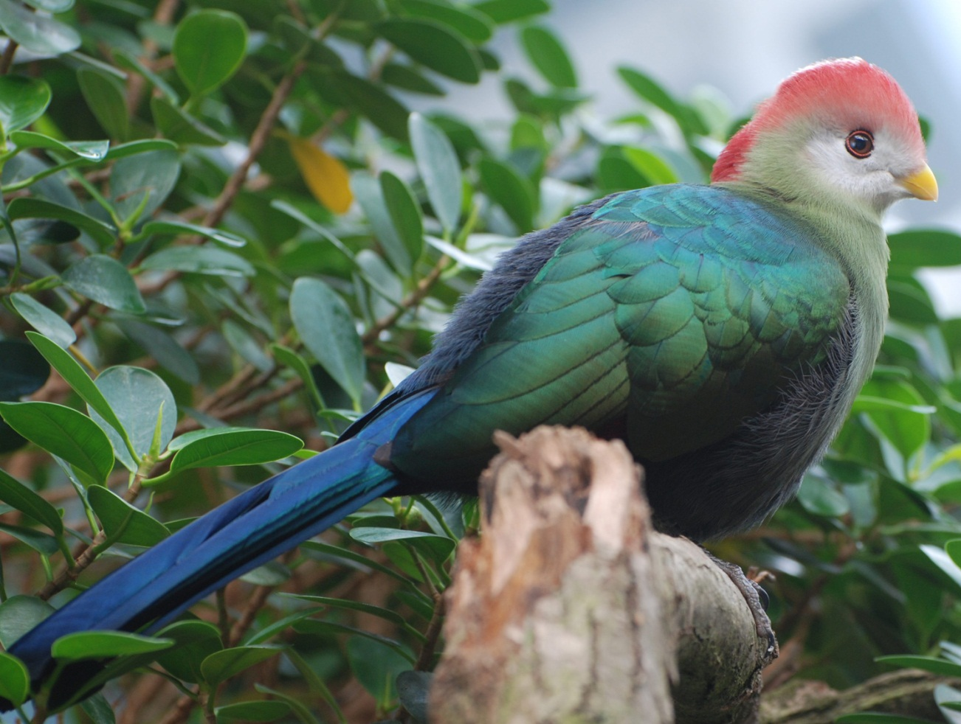
The Blackburn Pavilion
www.zsl.org/zsl-london-zoo/exhibits/birds
Spot the brightly-coloured tropical birds in the trees as you walk through this beautiful enclosure

Slide 18
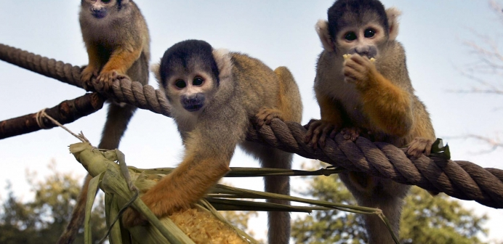
Meet the Monkeys
www.zsl.org/zsl-london-zoo/exhibits/meet-the-monkeys
Our cheeky monkeys may climb and jump right over your head!

Slide 19
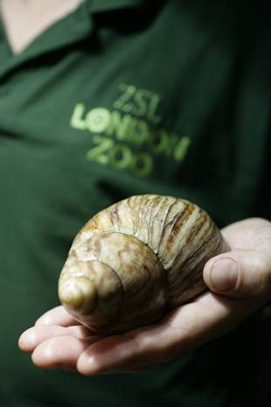
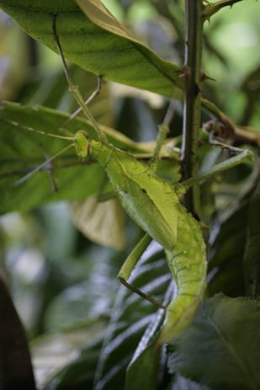
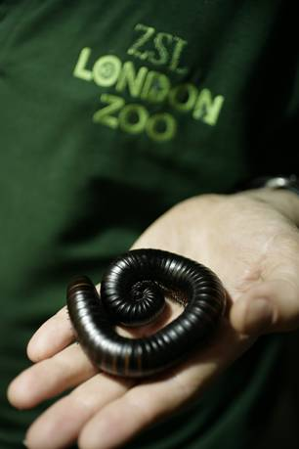
B.U.G.S. www.zsl.org/zsl-london-zoo/exhibits/bugs/
Hundreds of animals from ants to tarantulas can be found in B.U.G.S

Slide 20
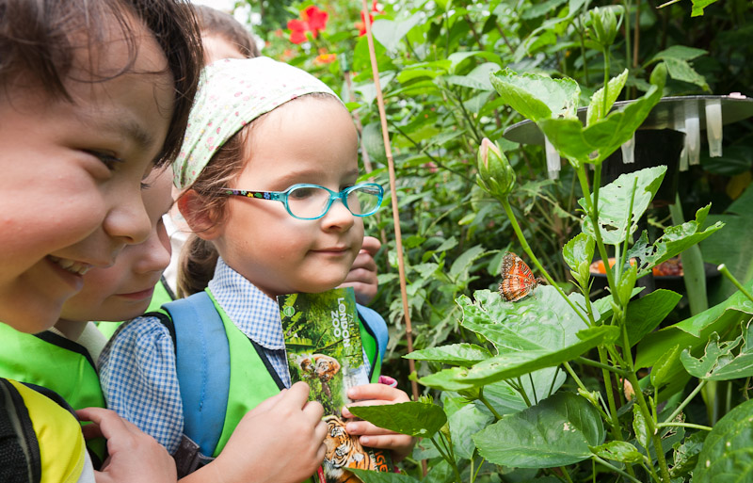
Butterfly Paradise
www.zsl.org/zsl-london-zoo/exhibits/butterfly-paradise
Walk inside and get up close to some beautiful butterflies!

Slide 21
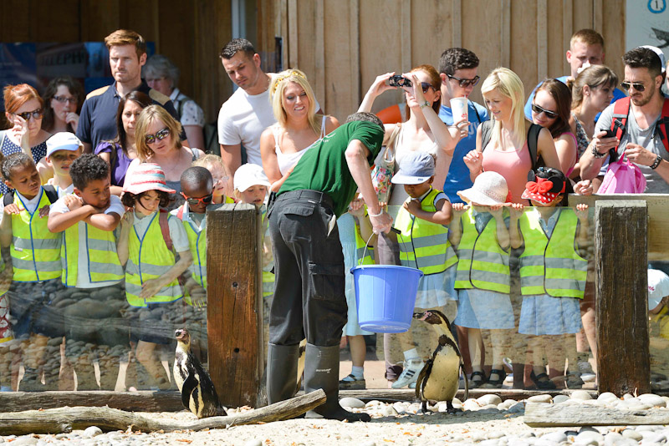
Penguin Beach www.zsl.org/zsl-london-zoo/exhibits/penguins/
You will find Ricky the Rockhopper Penguin and his friends at Penguin Beach.

Slide 22
Rainforest Life www.zsl.org/zsl-london-zoo/exhibits/rainforest-life Walk through our rainforest to spot monkeys, birds, insects, and sleepy sloths

Slide 23
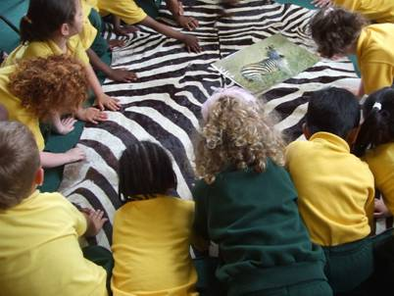
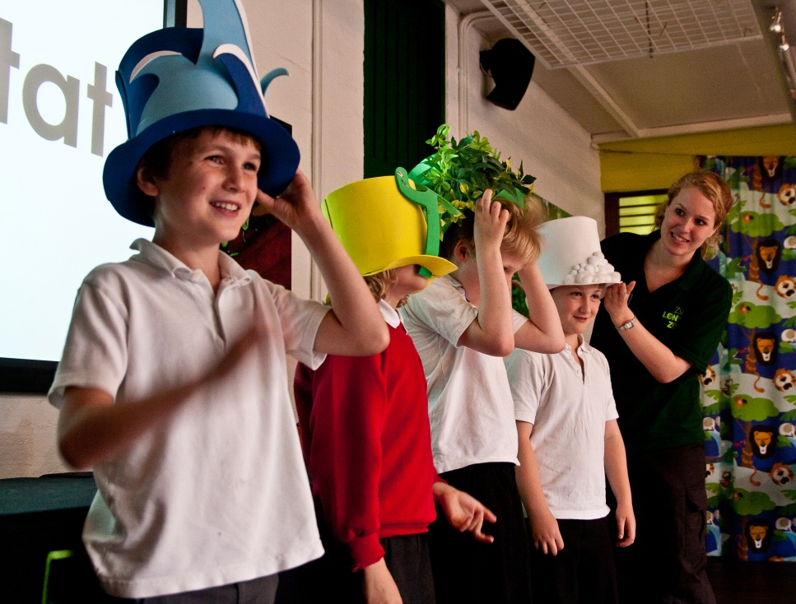
C. A session with a Discovery & Learning Officer
You may have the chance to meet one of our Discovery & Learning staff for an exciting activity.
These are lots of fun - you may get to touch real objects from the natural world or even meet a live animal!

Slide 24
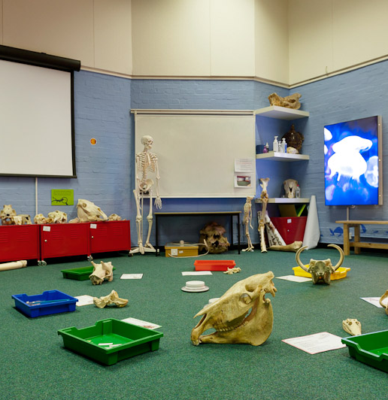
Your workshop activity could be in a room like this!

Slide 25
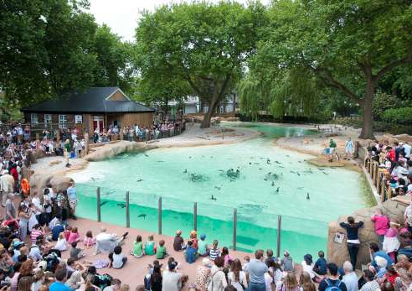
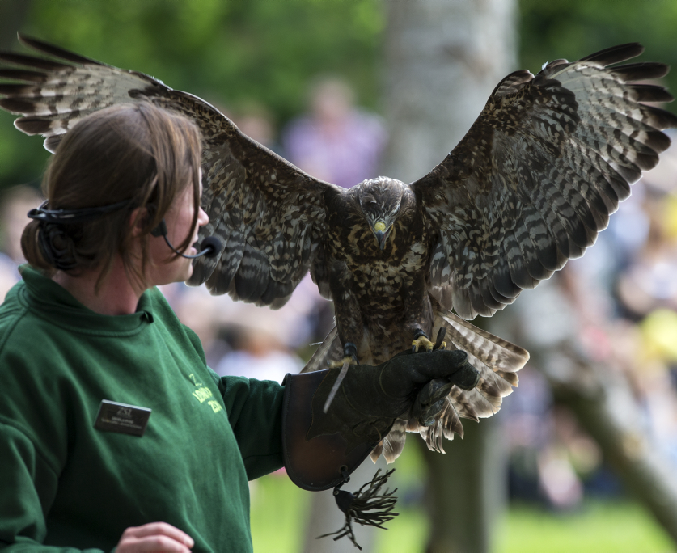
D. Free talks and events
www.zsl.org/zsl-london-zoo/visit/daily-events/
There are lots of talks and events happening around the Zoo you may wish to see. Maybe you’ll go to see the Penguin Beach Live talk, or the exciting Animals in Action show!

Slide 26
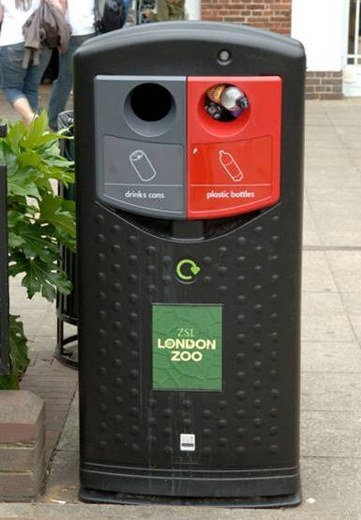
Eating lunch
E. Some extra information
If it is sunny you can eat your lunch outside on the grass.
If it is not so warm you can eat lunch in one of the covered areas around the Zoo
Remember to put your litter into a bin – or even better, a recycling bin!

Slide 27
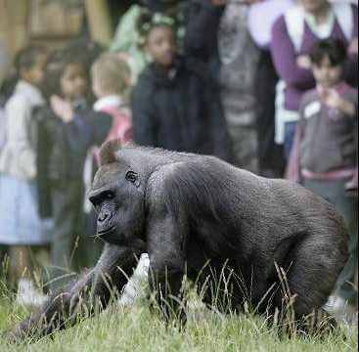
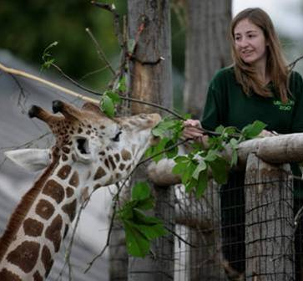
When you are visiting the animals
To see the animals behaving naturally, it’s great when visitors are very quiet so the animals don’t feel scared
Our animals are fed special diets. Make sure they don’t get any extra food from visitors as it can harm them

Slide 28
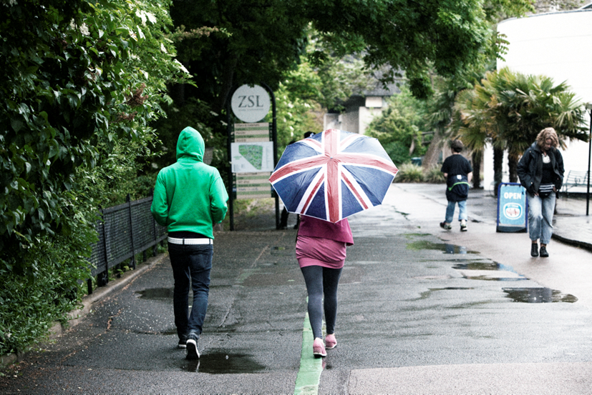
Don’t worry if it rains!
www.zsl.org/zsl-london-zoo/visitor-information/indoor-zsl-london-zoo-guide
It is not always sunny at ZSL London Zoo but we have a lot of inside spaces you can visit!
Make sure you have the right shoes and clothing for your visit if the weather is going to be wet.

Slide 29
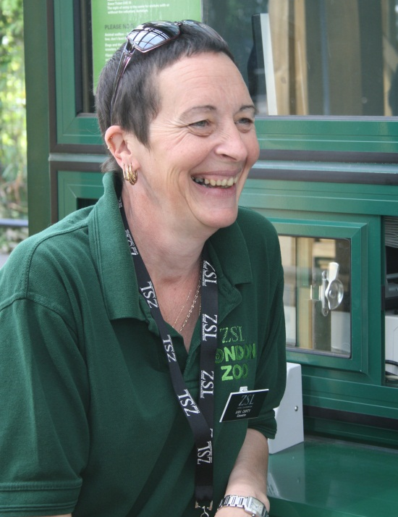
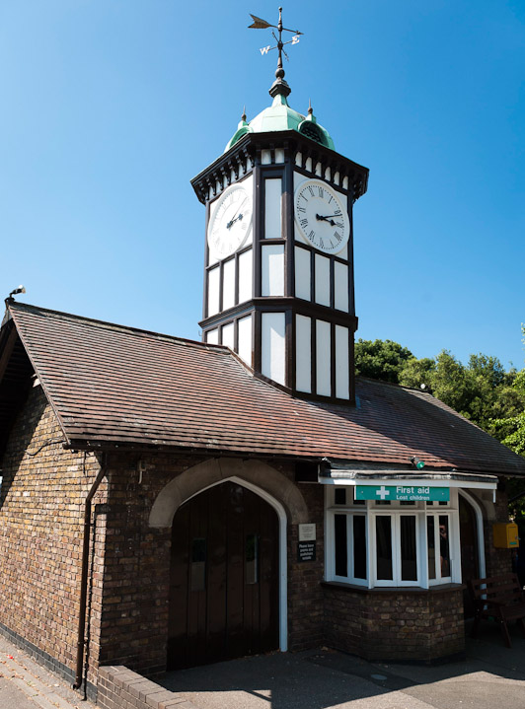
If you get lost…
Make sure you know the adult who is with your group on the day.
If you get lost, find one of the zoo workers (wearing a green uniform) – they’ll take you to our Clock Tower where your adults will come and meet you.

Slide 30
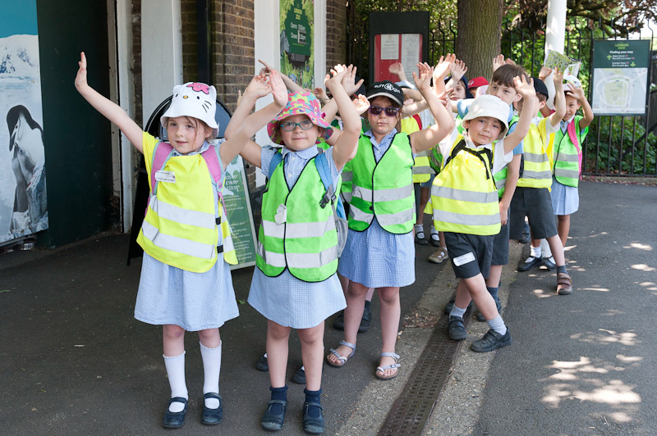
F. When you leave the Zoo
At the end of the day it’ll be time to say goodbye to the Zoo and go back to school – remember to come back and see us soon!

Slide 31
4. After your visit
We greatly appreciate any feedback from teachers, so please fill out the online questionnaire at: www.surveymonkey.com/s/ZSLLZEducation
For your next visit, make sure you check out the ZSL What’s On calendar www.zsl.org/zsl-london-zoo/whats-on/
If you need to get in touch, email us at learning@zsl.org
If you would like to keep up to date with learning news and events at ZSL London Zoo, make sure you sign up to receive the ZSL education e-news at www.zsl.org/zsl-london-zoo/schools/sign-up-for-emails

